Slide 1



Prestwick Cricket Club
Junior Section Welcome Pack
United Dynamic Integrity Determined Inclusive Excellence

Slide 2


A Warm Welcome To Prestwick Cricket Club
Replace age if wanted
The aim of this pack is to provide parents and players, both new and existing, with information about the club, the coaching and what you and your children can expect.

Slide 3



General Information
Prestwick Cricket Club provides opportunities for all young people, their parents and volunteers to become involved in cricket.
The club encourages fun, participation, sportsmanship and the social aspects of sport to anyone interested in participating. All we ask in return is that you respect the other members of the club, other teams and officials who support the game.
Prestwick Cricket Club is part of Cricket Scotland, the National Governing Body of the sport. The Junior teams of the club participate in national cup competitions organised by Cricket Scotland and league/cup competitions administered by the Western District Cricket Union

Slide 4
Training Dates & Times
Training for children is held at the following times at Prestwick Cricket Club, 11 Ayr Road, Prestwick, KA9 1SX.
Team Name/Age Group: | Dates: | Times: | Team Contact
Under 12s/14s/16s | Late April 2025 – End August/start September 2025 | Wednesday 17:00 – 18:45 | Gavin Pitt gavin_pitt@hotmail.co.uk 07855 975501
Under 10s/12s | Late April 2025 – End August/start September 2025 | Sunday 10:00 – 11:00 | Gavin Pitt gavin_pitt@hotmail.co.uk 07855 975501

Slide 5

Pick Up & Drop Off
Drop Off/Pick Up Times
Training starts at 17:00 on Wednesdays for U12/14/16 & on Sundays for U10/12 at 10:00 and ends at 18:45 on Wednesdays for U12/14/16 & at 11:00 on Sundays for U10/12. Coaches are setting up and are not able to be available to supervise children dropped off earlier than these times. Late arrival causes disruption and affects the quality of training, however, we understand situations can arise.
Children must be collected at 18:45 on Wednesdays & at 11:00 on Sundays prompt and where parents/carers are happy to allow their children to make their own way home, the Junior Convener or coach should be informed in advance.
If you are running behind for pick-up, please notify the contact listed on the previous page, Gavin Pitt via text message or phone call on 07855 975501 as soon as possible.

Slide 6


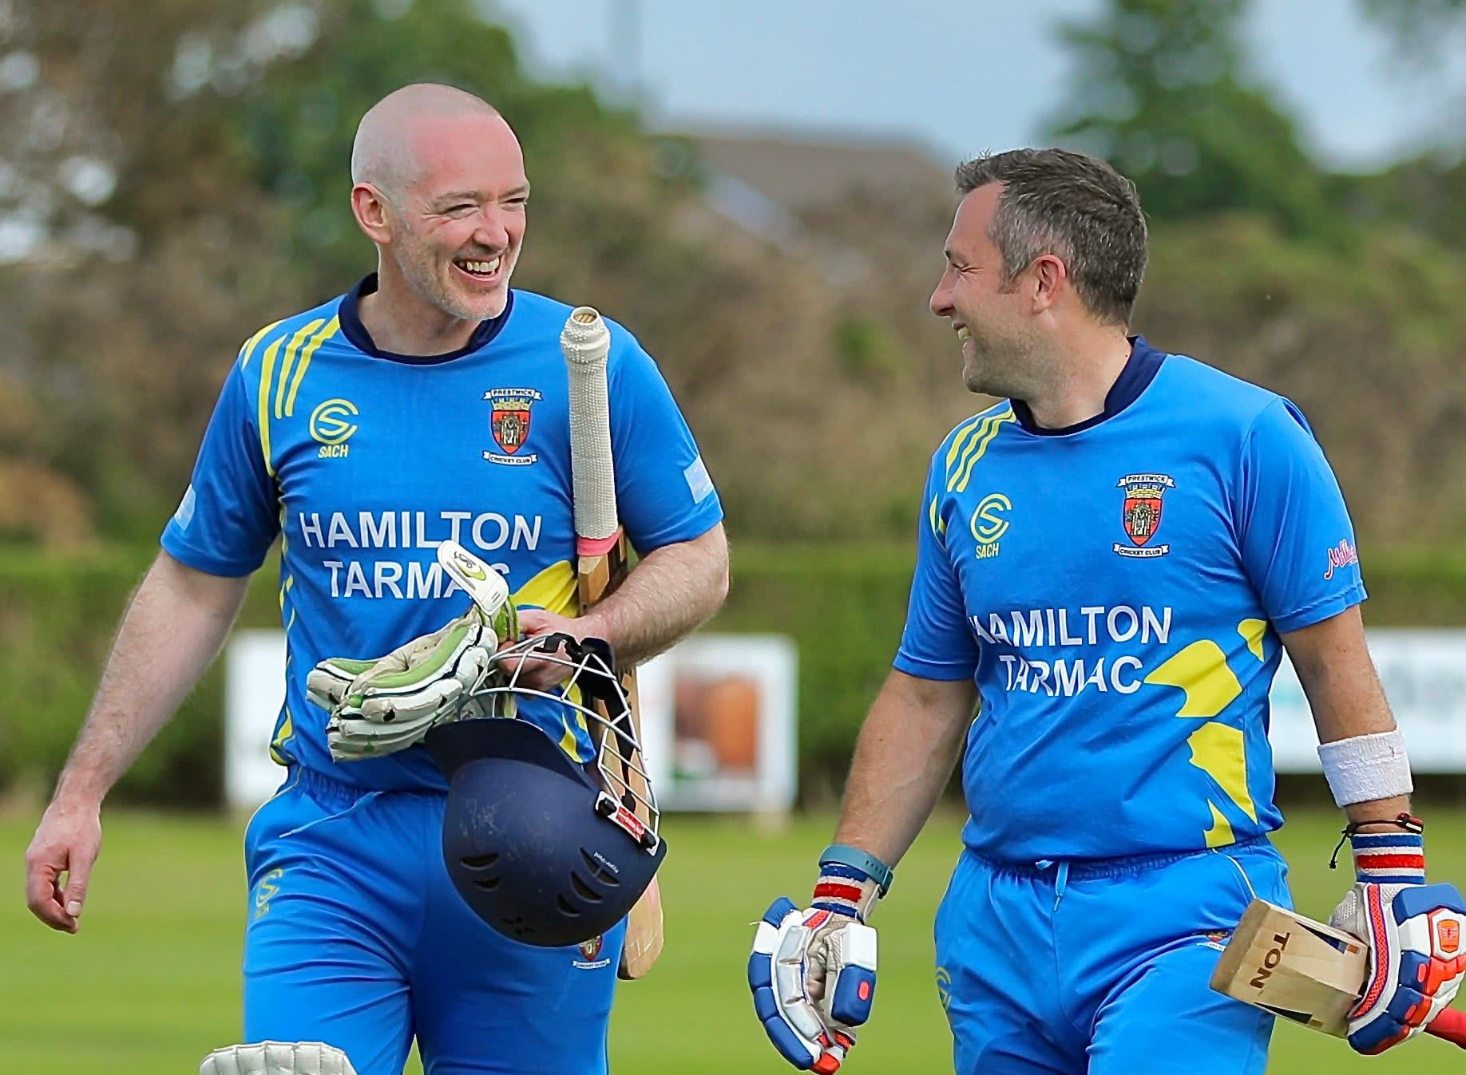



Equipment and Protection
Our junior members are welcome to train in whatever they feel comfortable in as long as it is safe. This generally means comfortable fitting clothing and closed toes trainers/shoes.
We also have Prestwick Cricket Club training and playing kit that can be viewed and ordered at SACH Sportswear, sachsportswear.co.uk or by contacting Sachin Chaudhary on sachinspania@gmail.com or 07900 446509.
Replace image if wanted
(e.g club shirt)
We aim to provide club equipment that members can borrow at our sessions.
Regardless of whether using their own or club equipment, juniors must always wear a helmet when batting against a cricket ball, compliant to the current BS safety standards and in reasonable working condition.
Although we aim to have a functional range of pads, gloves, bats and helmets for our members to access (with the necessary sanitisation protocols in place), abdominal protectors cannot be shared. Members wishing to use these must bring their own.

Slide 7
Communication & Social Media
Add about emergency contact forms & permission for images/social media.

Slide 8
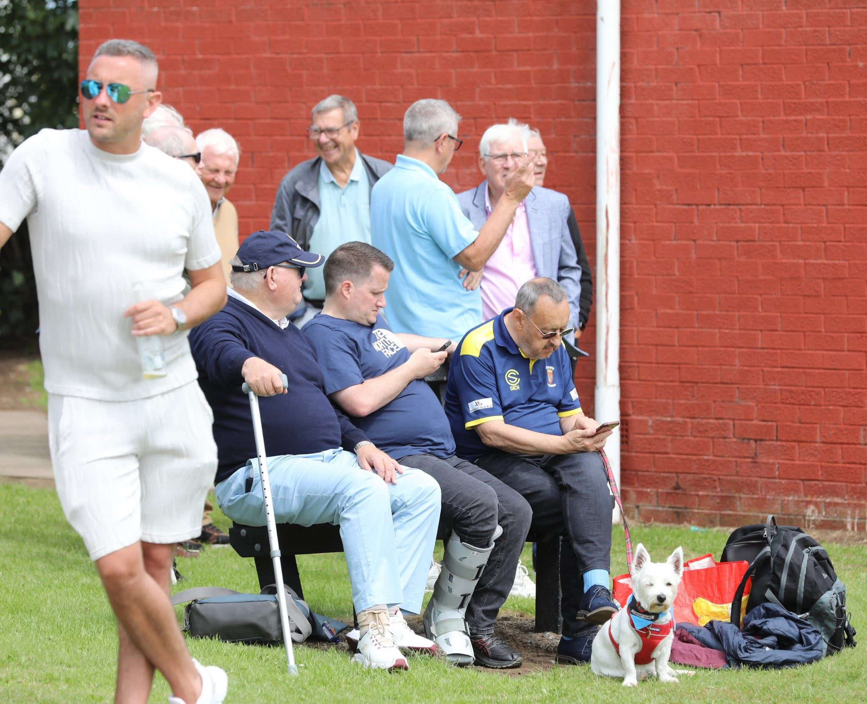
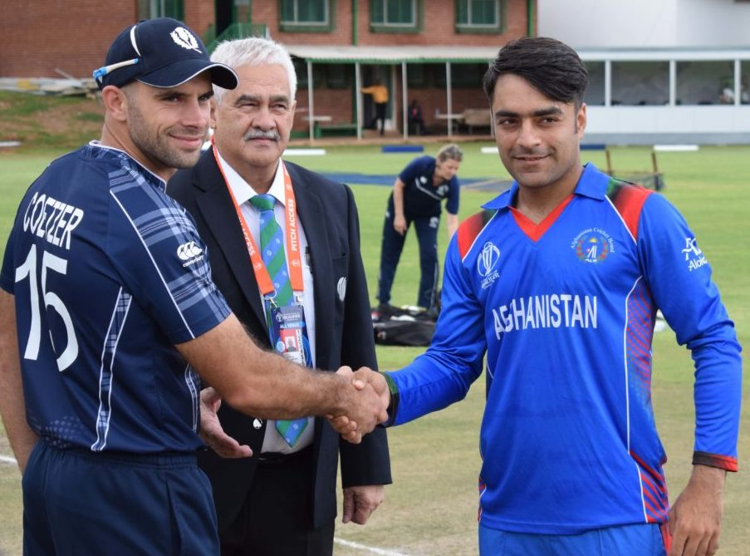
Meet The Club Family
Club Executives:
President… Ian McKinnell
Contact Number…07745 727959
Email… imckinnell@sky.com
Secretary… Fiona Chalmers
Contact Number…07929 056861
Email… fiona.b.chalmers@gmail.com
Treasurer… Brian Crook
Contact Number…07900 457924
Email… bjcpik@gmail.com
Junior Convener… Gavin Pitt
Contact Number…07855 975501
Email… gavin_pitt@hotmail.co.uk
As with most sports clubs, Prestwick Cricket Club is run by volunteers. These people are players, parents and supporters who give their time to ensure children benefit. They administer the club, conduct the coaching and help transport children to activities and games.
Replace image if wanted

Slide 9


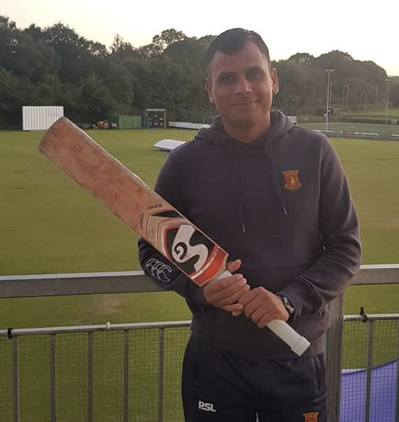


Putting A Face To The Name
Lead Coach… Sachin Chaudhary
CWPO…Tommy Halpin
Women & Girls Lead Coach… Holly Druce
+44 7900 446509
sachinspania@gmail.com
+44 (0)7801 642312
tphalpin1@aol.com
+44 (0)7507 165983
hollydruce43@gmail.com

Slide 10
Child Wellbeing & Protection Policy Statement
Underpinning principles:
A child is recognised as someone under the age of 18
A child has the right to relax, play and join in a wide range of sporting activities
The protection and wellbeing of all children in our care is everyone’s responsibility
A child, whatever their age, culture, disability, gender, language, racial origin, socioeconomic status, religious belief and/or sexual identity has the right to protection from all forms of harm and abuse
A child has the right to express views on all matters that affect them, should they wish to do so
A child’s rights, wishes and feelings should be respected and promoted
The best way to promote the wellbeing, health and development of a child is to work in partnership with the child, parents/carer’s and other relevant organisations
Prestwick Cricket Club is fully committed to safeguarding, promoting and supporting the protection and wellbeing of all children in our care. We recognise our responsibility to promote safe practice and to protect children from harm, abuse and exploitation. We embrace difference and diversity and respect the rights of all children and young people. Everyone at the Club will be made aware of the policies and procedures in place to protect children in our care and to promote their wellbeing.

Slide 11
Child Wellbeing & Protection Policy Statement
To keep children safe in our Club we will:
• Promote the wellbeing of children through opportunities to take part in cricket safely
• Put in place policies and procedures to promote the wellbeing and protection of children
• Appoint a Club Child Wellbeing and Protection Officer
• Recruit, train and support our cricket volunteers/staff to prioritise the wellbeing of children who take part in our activities and protect them from harm
• Require our cricket volunteers/staff to adopt and abide by the child protection policy and procedures including the Code of Conduct for working with children
• Respond to any child wellbeing or protection concerns in line with our policy and procedures.
• Monitor, review and evaluate the implementation of the child wellbeing and protection policy and procedures regularly If you have any concerns about the wellbeing of a child at our Club, please do not hesitate to contact the Club Child Wellbeing and Protection Officer (CWPO)
Replace with image of Club CWPO
For more information on our Child Wellbeing and Protection Policy, please contact Tommy Halpin
on tphalpin1@aol.com or 07801 642312

Slide 12

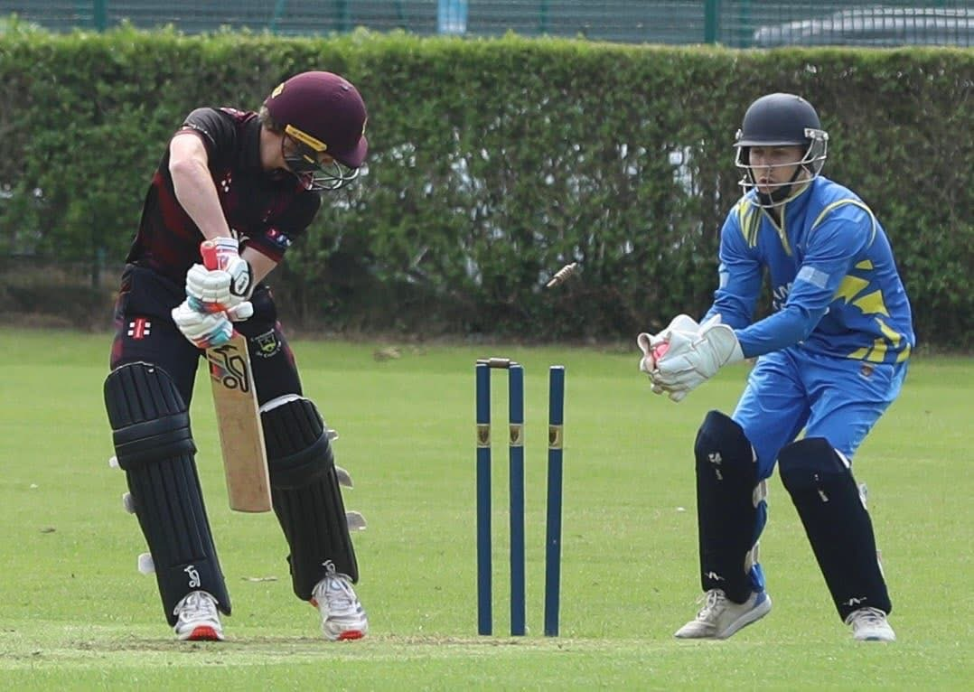

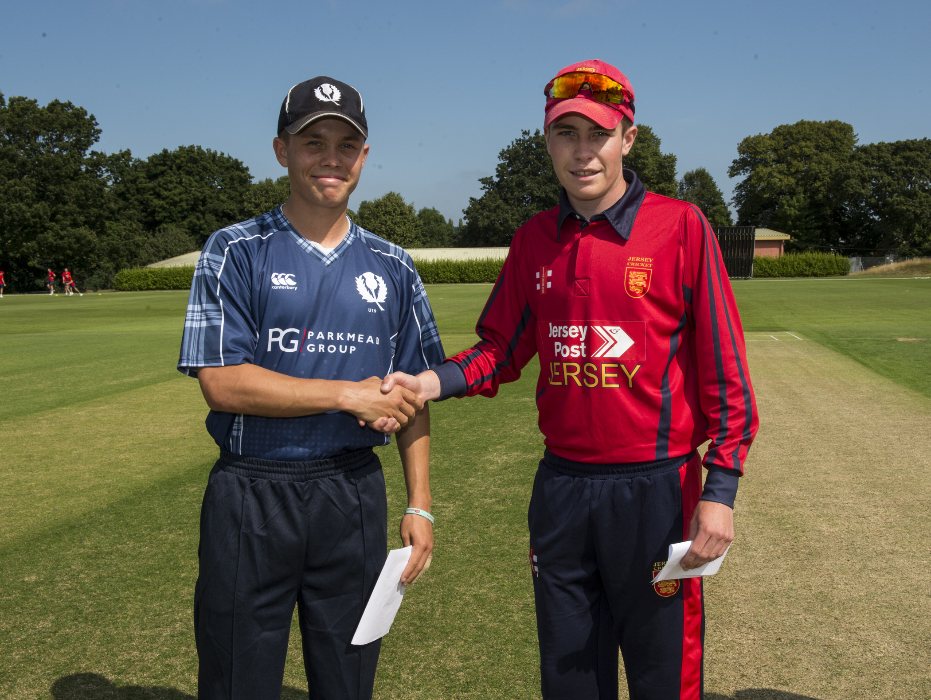


What Does Great Look Like?
The Children’s Parliament asked kids what wellbeing and protection looked like to them.
See what they said by scanning the QR code or going to
https://tinyurl.com/2tjk2t4x

Slide 13
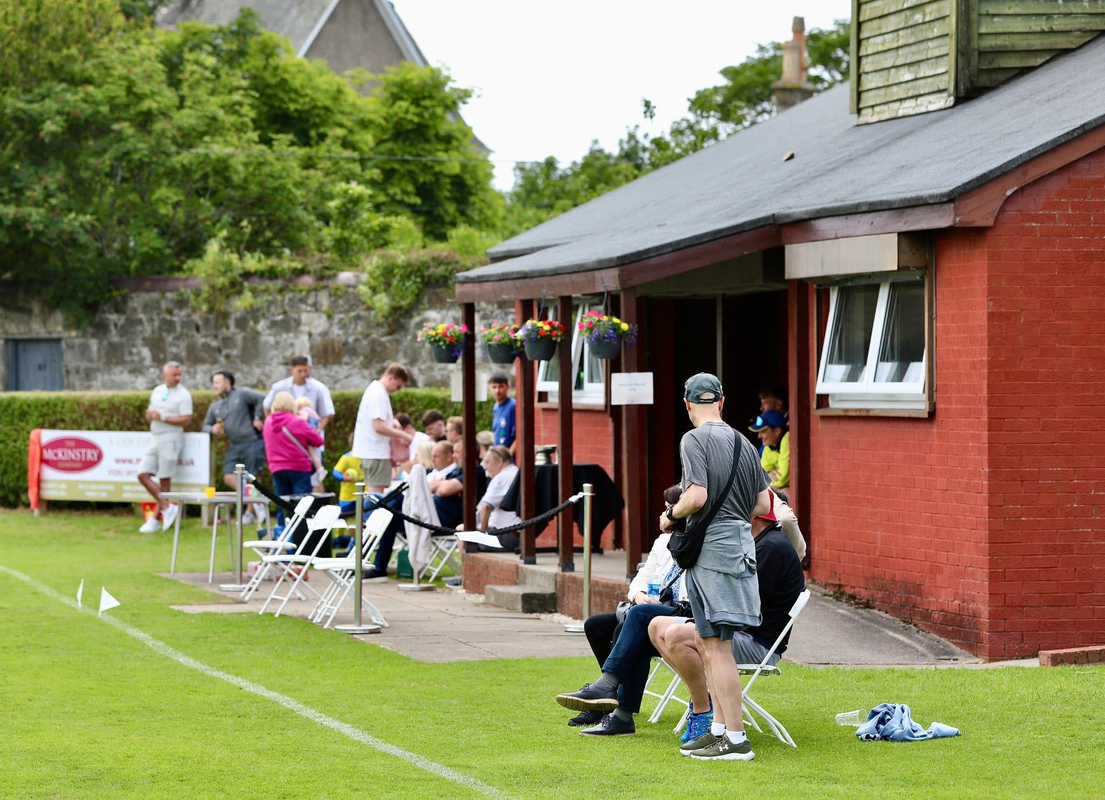
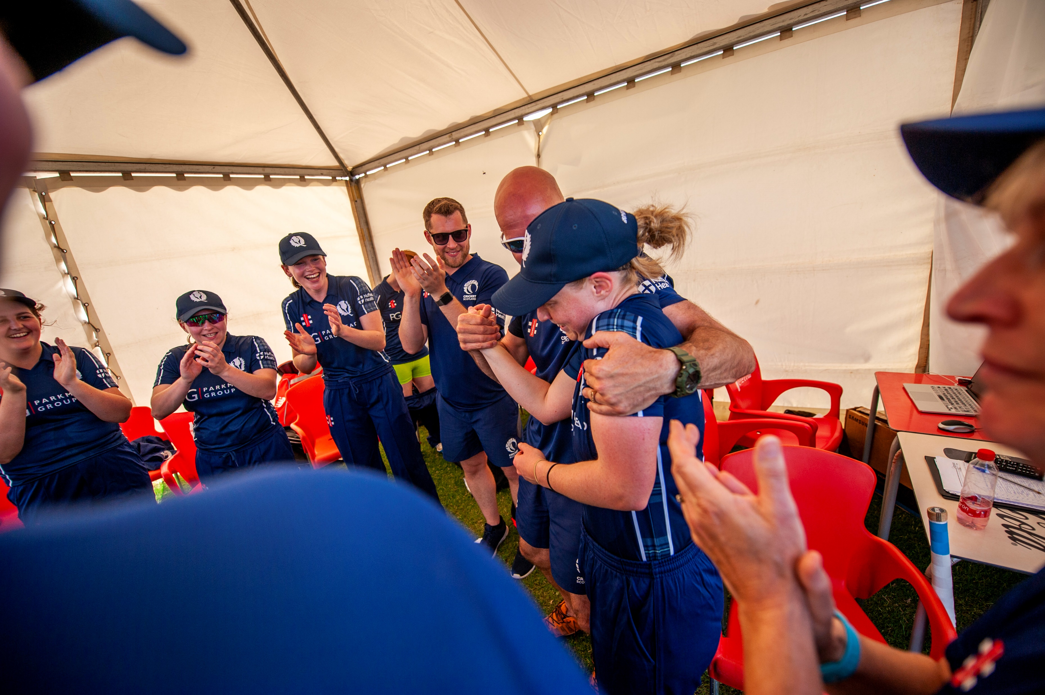
Prestwick Cricket Club Code Of Conduct
Replace image if wanted
Prestwick Cricket Club requires all members and players to observe the following standards of practice, including verbal and non-verbal actions when involved in activities with children. All concerns about a breach of these Codes of Conduct will be taken seriously and responded to in line with Prestwick Cricket Club Procedures for Responding to Concerns about Child Abuse.

Slide 14






Code of Conduct - Our Promise To You
Prestwick Cricket Club coaches, volunteers will embody Good Practice towards all its junior members by...
...being role models – welcoming, positive, encouraging and respectful ​
...making cricket fun, enjoyable and promote fair play​​
...implementing and championing Club Safe in Cricket Guidelines
...treating all children equally, with respect, dignity and fairness
...involving parents/carers wherever possible
...building balanced relationships based on mutual trust

Slide 15






Code of Conduct - Our Promise To You
Prestwick Cricket Club coaches, volunteers will embody Good Practice towards all its junior members by...
...including children in the decision-making process whenever possible ​
...working with children in a public place, wherever possible ​​
...putting the wellbeing of each child first before winning or achieving
...giving enthusiastic and constructive feedback
...recognizing the developmental needs and capacity of children
...challenging instances of poor practice, abuse or bullying

Slide 16










Code of Conduct – What’s Not Accepted
Unacceptable practice within Prestwick Cricket Club includes...
...putting excessive pressure on children, pushing children against their will ​
...giving only negative feedback​​
...unequal treatment that could lead to resentment, jealousy or misinterpretation
...taking photographs without the appropriate consent ​
...spending a lot of time alone with children away from others
...assisting with bathing or dressing tasks that children can do for themselves
...smoking, drinking alcohol, misuse of illegal substances or the use of foul or offensive language
...failing to pass on a disclosure from a child about potential abuse

Slide 17









Code of Conduct – What’s Not Accepted
Unacceptable practice within Prestwick Cricket Club includes...
...inviting or allowing children to stay with you at your home or sharing a bedroom alone with a child
...allowing allegations or observations of bullying or abuse to go unchallenged, unrecorded or not acted on
...touching a child in a sexually suggestive way, playing sexually provocative games or making sexually suggestive comments to a child, even in fun
...threatening, coercing or bullying a child or deliberately reducing a child to tears as a form of control
...unofficial communication with a child through telephone or social media
...forming intimate emotional, physical or sexual relationships with children
...allowing the use of swearing, sexualised, racist or homophobic language by staff/volunteers or children
...rough physical contact or games between adults and children

Slide 18
Prestwick Cricket Club Anti-Bullying Policy
Prestwick Cricket Club is committed to providing a caring, friendly and safe environment for all our children so that they can train, and play, in a relaxed and secure place. Bullying can take many forms, none of which are acceptable at our Club.
Verbal
Racial, sexist or homophobic
Indirect
Physical
offensive name-calling, insults or gossiping
Non-verbal/Cyber
racist remarks, sexist jokes or comments, or homophobic, transphobic or gender-related jokes or comments
Sexual
spreading nasty stories or rumours about someone, intimidation, exclusion from social groups, manipulating or constantly undermining someone
hitting, pushing, kicking or other physical assault
offensive hand signs or text messages
abusive sexualised name-calling, inappropriate and uninvited touching, or an inappropriate sexual proposition

Slide 19


Responding to Bullying
Bullying results in pain or distress to the victim. Prestwick Cricket Club is committed seeks to ensure, as far as is reasonably practical, the prevention of all forms of bullying among members. Any instances of bullying can be reported by the victim or onlookers to the CWPO, a coach or another committer member. Any reports follow the process outlined below.
Report bullying incidents to the Club Child Wellbeing & Protection Officer, a coach, or a member of the committee
In cases of serious bullying, the incidents will be referred to the CS for advice.
An attempt will be made to help the bully (bullies) change their behaviour
The bullying behaviour or threats of bullying must be investigated and the bullying stopped quickly.
Parents should be informed and will be asked to come in to a meeting to discuss the problem.
If mediation fails and the bullying is seen to continue the club will initiate disciplinary action under the club constitution or where appropriate under Prestwick Cricket Club’s Disciplinary Procedures.
If necessary and appropriate, police will be consulted.

Slide 20

Feeling Emotions
Cricket is a sport for everyone. It is important for all players to feel included. All coaches understand that you will feel differently every time you join us. Let us know how you feel at each session.
If you are worried about something don’t keep it to yourself. Speak to an adult who you know and trust such as a parent, teacher, the Child Wellbeing and Protection Officer at the Club, a guidance teacher, doctor or school nurse

Slide 21
Further Information and Support
Link to club CWP Policy
Link to club websites/social
Link to club kit store
https://childreninscotland.org.uk/
https://www.children1st.org.uk/help-for-families/child-wellbeing-and-protection-in-sport/
https://thecpsu.org.uk/
https://www.gov.scot/policies/girfec/

